Slide 1
Programming Fundamental
Week 03
Sobia Iftikhar
Sobia.Iftikhar@nu.edu.pk

Slide 2
Class 07

Slide 3
Content
- More on input and output functions
Variables
Data Types
Format Specifiers
Constant
Keywords
Escape Sequences

Slide 4
Variables
A variable is nothing but a name given to a storage area that our programs can manipulate. Each variable in C has a specific type, which determines the size and layout of the variable's memory; the range of values that can be stored within that memory; and the set of operations that can be applied to the variable.
type variable_list;

Slide 5
Rules for defining variables
A variable can have alphabets, digits, and underscore.
A variable name can start with the alphabet, and underscore only. It can't start with a digit.
No whitespace is allowed within the variable name.
A variable name must not be any reserved word or keyword, e.g. int, float, etc.

Slide 6
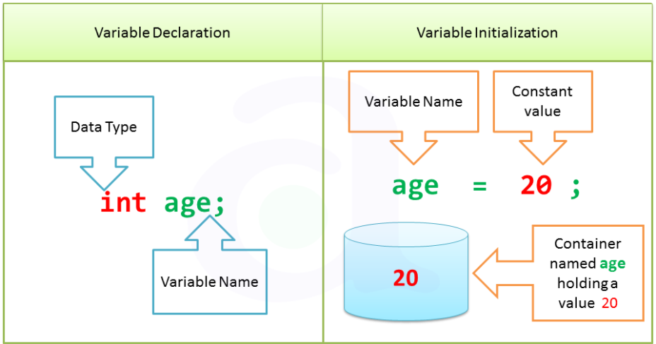


Variable Declaration and initialization

Slide 7
Types of Variables in C
local variable
global variable
static variable
automatic variable
external variable

Slide 8

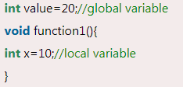
Local Variable
A variable that is declared inside the function or block is called a local variable.
It must be declared at the start of the block.
Global Variable
A variable that is declared outside the function or block is called a global variable. Any function can change the value of the global variable. It is available to all the functions.

Slide 9
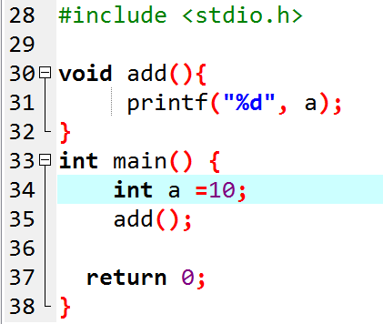
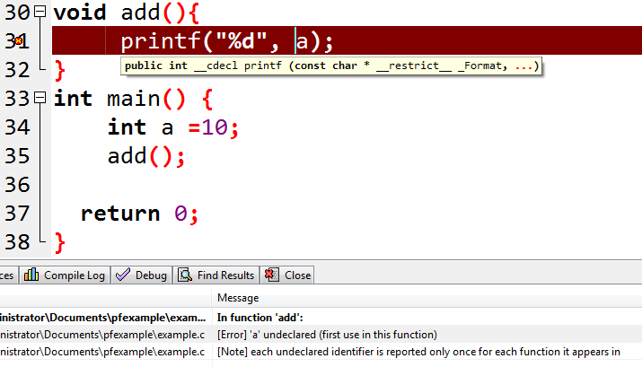

Slide 10
Static variables
In programming, a static variable is the one allocated “statically,” which means its lifetime is throughout the program run. It is declared with the ‘static’ keyword and persists its value across the function calls.
static data_type variable_name;

Slide 11
Static variable
#include <stdio.h>
void foo()
{
int a = 10;
static int sa = 10;
a += 5;
sa += 5;
printf("a = %d, sa = %d\n", a, sa);
}
int main()
{
int i;
for (i = 0; i < 10; ++i)
foo();
}
a = 15, sa = 15
a = 15, sa = 20
a = 15, sa = 25
a = 15, sa = 30
a = 15, sa = 35
a = 15, sa = 40
a = 15, sa = 45
a = 15, sa = 50
a = 15, sa = 55
a = 15, sa = 60

Slide 12

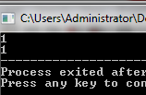
Example
int main()
{
printf("%d",func());
printf("\n%d",func());
return 0;
}
int func()
{
int count=0;
count++;
return count;
}
What if I put static in line no. 10 before “int” ?
int main()
{
printf("%d",func());
printf("\n%d",func());
return 0;
}
int func()
{
static int count=0;
count++;
return count;
}

Slide 13
Class 08

Slide 14
Data types
Data type in C
Basic
Derived
Enumeration
void

Slide 15
There are the following data types in C language.
Types | Data Types
Basic Data Type | int, char, float, double
Derived Data Type | array, pointer, structure, union
Enumeration Data Type | enum
Void Data Type | void

Slide 16
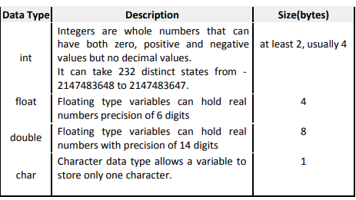
DATATYPES IN C

Slide 17
Basic Data types
Type | Size (bytes) | Format Specifiers
int | at least 2, usually 4 | %d, %i
char | 1 | %c
float | 4 | %f
double | 8 | %lf
short int | 2 usually | %hd
unsigned int | at least 2, usually 4 | %u
long int | at least 4, usually 8 | %ld, %li
long long int | at least 8 | %lld, %lli
unsigned long int | at least 4 | %lu
unsigned long long int | at least 8 | %llu
signed char | 1 | %c
unsigned char | 1 | %c
long double | at least 10, usually 12 or 16 | %Lf

Slide 18
Basic Data types-ranges
Type | Storage size | Value range
char | 1 byte | -128 to 127 or 0 to 255
unsigned char | 1 byte | 0 to 255
signed char | 1 byte | -128 to 127
int | 2 or 4 bytes | -32,768 to 32,767 or -2,147,483,648 to 2,147,483,647
unsigned int | 2 or 4 bytes | 0 to 65,535 or 0 to 4,294,967,295
short | 2 bytes | -32,768 to 32,767
unsigned short | 2 bytes | 0 to 65,535
long | 8 bytes or (4bytes for 32 bit OS) | -9223372036854775808 to 9223372036854775807
unsigned long | 8 bytes | 0 to 18446744073709551615

Slide 19



int
Integers are whole numbers that can have both zero, positive and negative values but no decimal values. For example, 0, -5, 1.
We can use int for declaring an integer variable.
float and double
float and double are used to hold real numbers.
In C, floating-point numbers can also be represented in exponential. For example,
char
Keyword char is used for declaring character type variables. For example

Slide 20
Task
Example #1: C Output
Example #2: C Integer Output
Example #3: C Integer Input/Output
Example #4: C Floats Input/Output
Example #5: C Character I/O
Example #6: I/O of Floats and Integers
Notes:
#include <stdio.h> int main() { int integer = 9876; float decimal = 987.6543; // Prints the number right justified within 6 columns printf("4 digit integer right justified to 6 column: %6d\n", integer); // Tries to print number right justified to 3 digits but the number is not right adjusted because there are only 4 numbers printf("4 digit integer right justified to 3 column: %3d\n", integer); // Rounds to two digit places printf("Floating point number rounded to 2 digits: %.2f\n",decimal); // Rounds to 0 digit places printf("Floating point number rounded to 0 digits: %.f\n",987.6543); // Prints the number in exponential notation(scientific notation) printf("Floating point number in exponential form: %e\n",987.6543); return 0; }

Slide 21
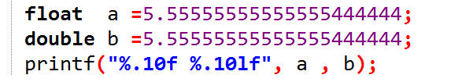
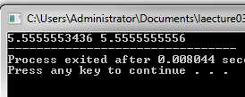
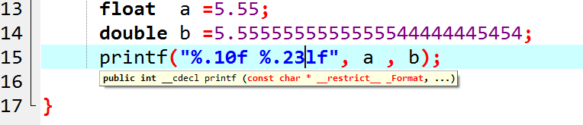
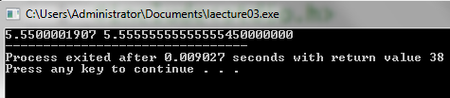
Float vs double

Slide 22
Signed vs unsigned
In C programming language, there are different varieties of data types, which are used to declare variables before they are used as they are data storage for a particular variable to perform particular tasks like int data types for integers, float for floating real numbers, etc.
In C, unsigned is also one data type in which is a variable type of int this data type can hold zero and positive numbers.
There is also a signed int data type in which it is a variable type of int data type that can hold negative, zero, and positive numbers. This unsigned int is data type cannot represent a negative number.

Slide 23
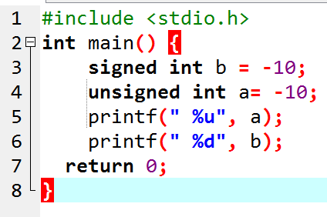
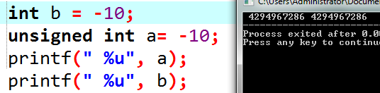

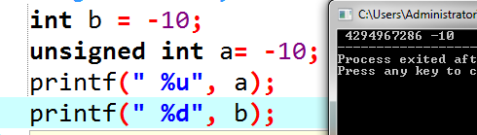
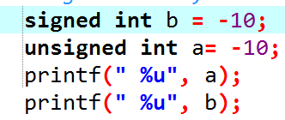

Signed and Unsigned int

Slide 24
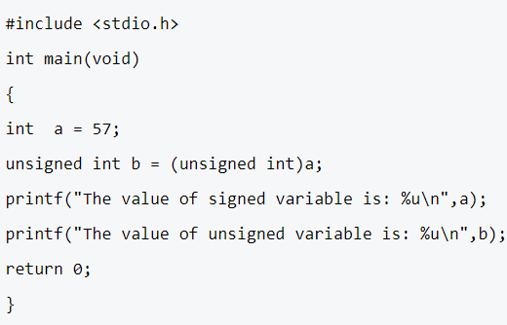

Example

Slide 25
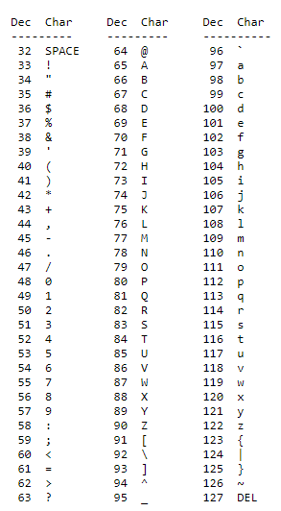
ASCII TABLE
ASCII, abbreviation of American Standard Code For Information Interchange, a standard data-transmission code that is used by smaller and less-powerful computers to represent both textual data (letters, numbers, and punctuation marks)

Slide 26
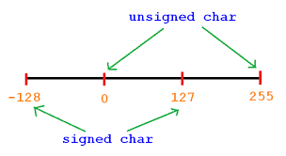
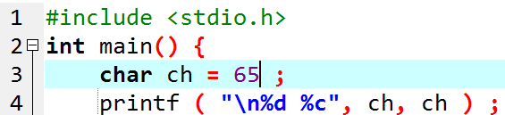

Signed and unsigned char
A signed char is same as an ordinary char and has a range from -128 to +127; whereas, an unsigned char has a range from 0 to 255.

Slide 27


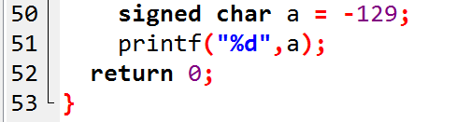

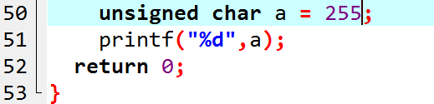
Example
Signed char [-128 --- + 127]
unSigned char [0 --- + 255]

Slide 28
Format Specifiers
SPECIFIER | USED FOR
%c | a single character
%s | a string
%hi | short (signed)
%hu | short (unsigned)
%Lf | long double
%n | prints nothing
%d | a decimal integer (assumes base 10)
%i | a decimal integer (detects the base automatically)
%o | an octal (base 8) integer
%x | a hexadecimal (base 16) integer
%p | an address (or pointer)
%f | a floating point number for floats
%u | int unsigned decimal
%e | a floating point number in scientific notation
%E | a floating point number in scientific notation
%% | the % symbol

Slide 29
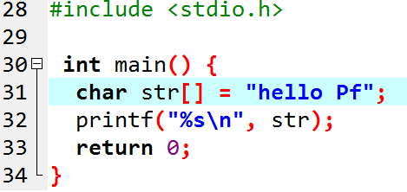

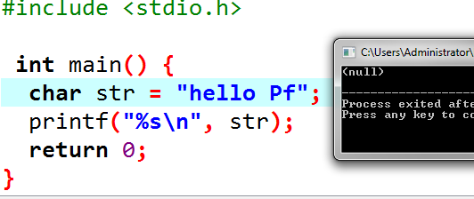
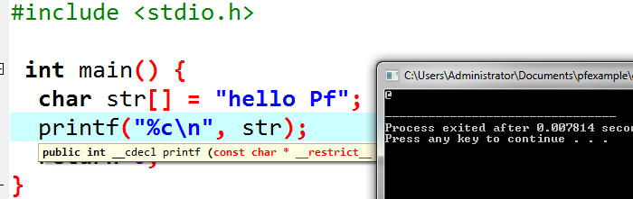
How to print string

Slide 30

Format Specifiers
%integervalue( sepcifer)

Slide 31
Escape sequences
Escape Sequence & Description
\t Inserts a tab in the text.
\b Inserts a backspace in the text.
\n Inserts a newline in the text.
\r Inserts a carriage return in the text.
\f Inserts a form feed in the text.
\’ Inserts a single quote character in the text.
\” Inserts a double quote character in the text.
\\ Inserts a backslash character in the text.
\? Inserts a question mark in the text.
\a Play beep or Alarm

Slide 32

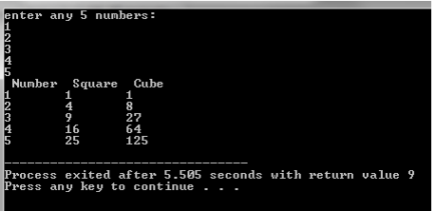

Slide 33
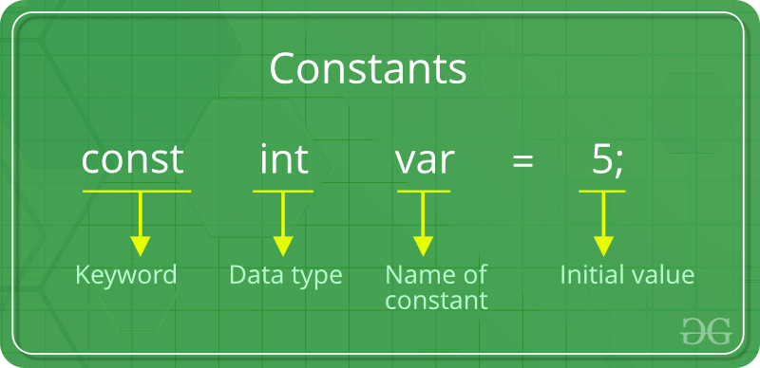
Defining Constants:
In C/C++ program we can define constants in two ways as shown below:
Using #define preprocessor directive
Using a const keyword
#define identifierName value

Slide 34
Why constant?
An advantage of using constants as well as variables may be a small increase in speed when your program runs on a computer.
but it also has the advantage that it makes your programs clearer and easier to understand.
If you declare a constant you are telling the people who read your program that this value never changes within the program and so whenever it is accessed it will be the same.
The mathematical value π (pi) is a constant value and if you were to use π in your programs you wouldn’t want to have to type out 3.14159 (or more decimal places) every time you needed it, nor would you ever want to give it any other value.

Slide 35
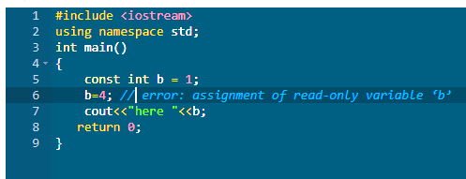

Constant Variables in C++
If you make any variable as constant, using const keyword, you cannot change its value. Also, the constant variables must be initialized while they are declared.

Slide 36
Class 09

Slide 37
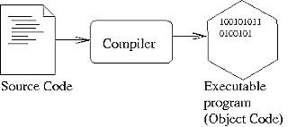
Linking, compiler, Loader
Compiler
A compiler is a computer program (or a set of programs) that transforms source code written in a programming language (the source language) into another computer language (the target language).
Typically, from high level source code to low level machine code or object code.

Slide 38
Loader
A loader locates programs in memory and prepares them for execution. It is an important component when starting a program. It includes tasks such as reading the content of the executable file and placing the file in memory.

Slide 39
Linking
After converting the source code into the object code, the linker performs the linking task. It takes one or more object files generated by the compiler and combines them together to generate an executable file.
Furthermore, it combines the object codes with libraries. For example, in a C program, if there is sqrt() function to calculate the square root of a number, the linker links the program with the math library. Finally, the CPU can read and understand the generated executable file. Therefore, the CPU can execute that file to perform the task defined in the program

Slide 40

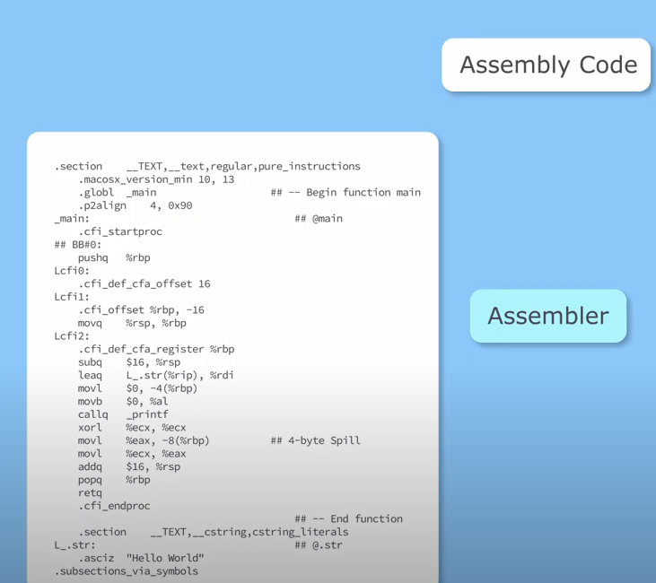
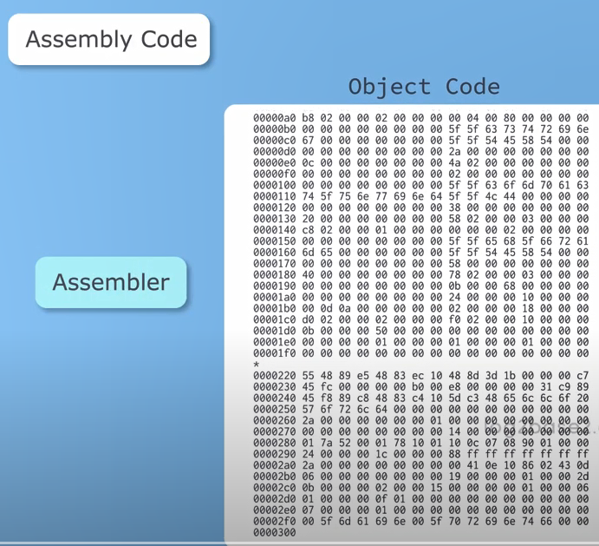
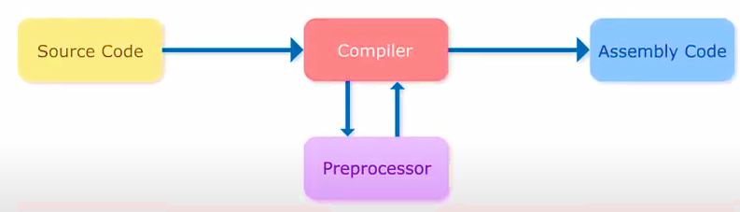
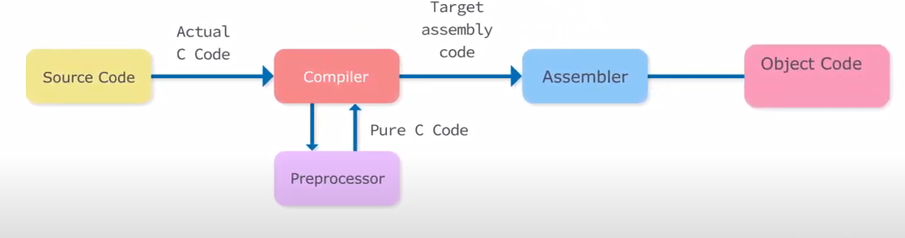
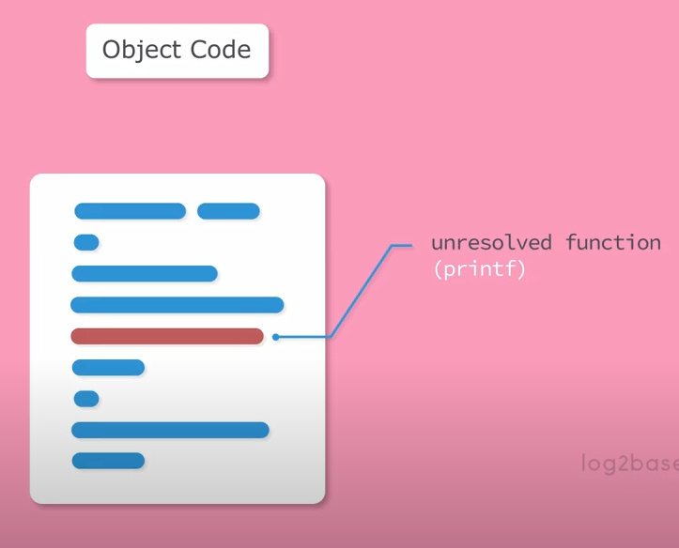

Slide 41
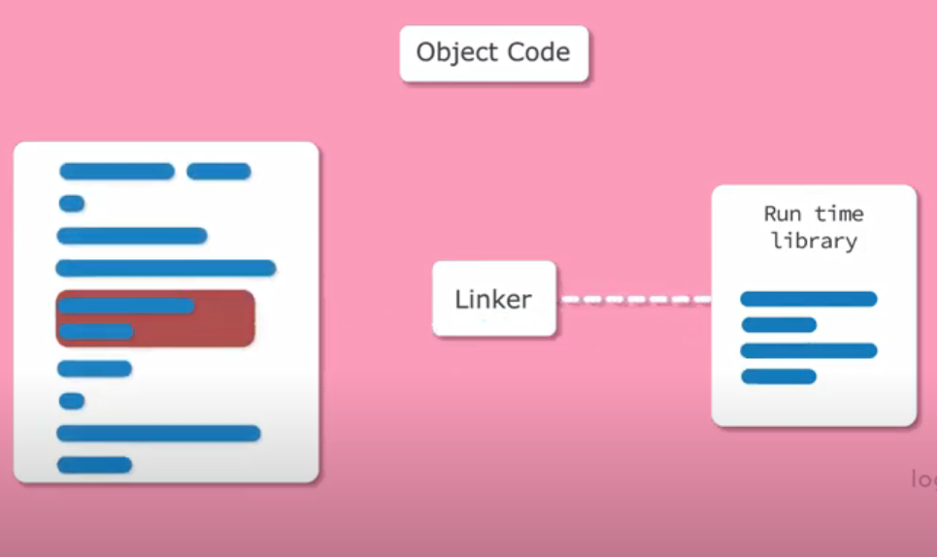
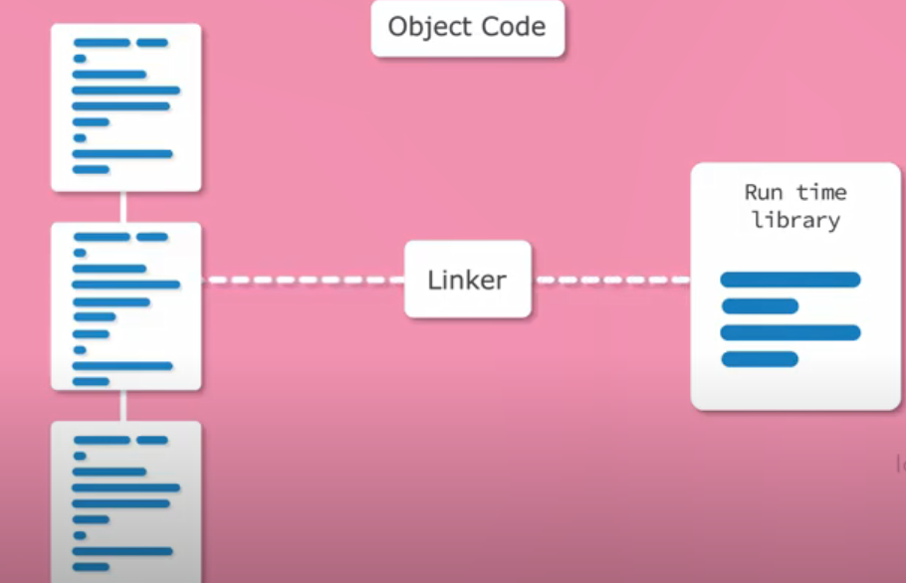
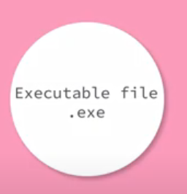
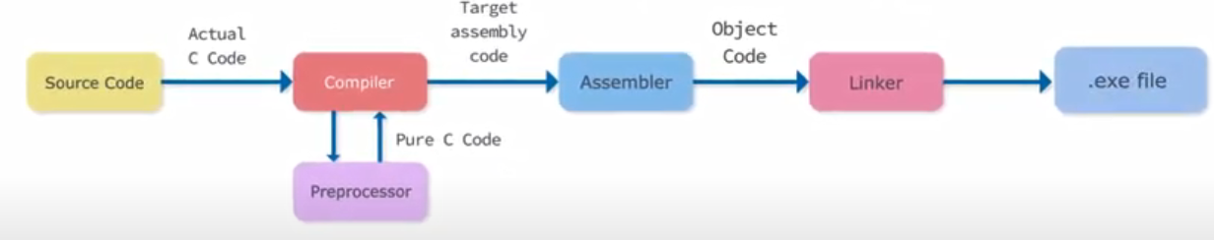

Slide 42
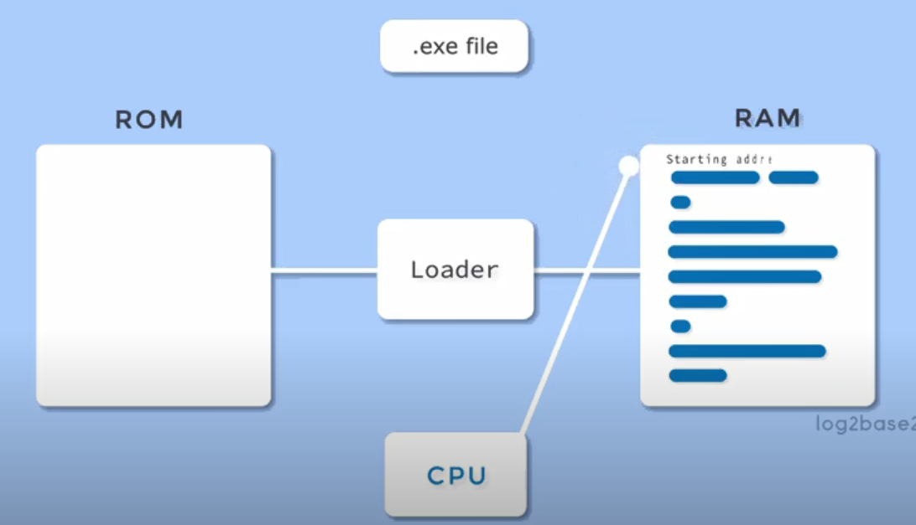
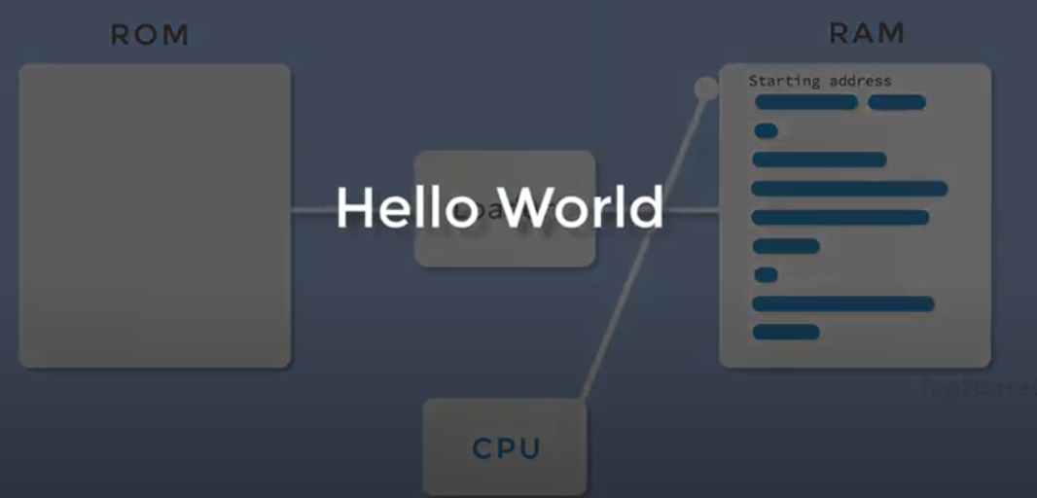
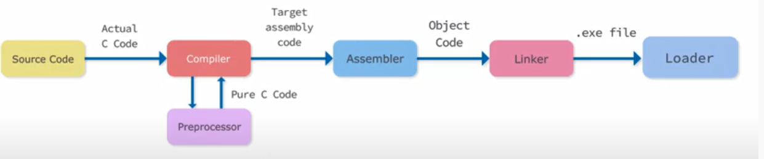

Slide 43
Operators
C Arithmetic Operators
C Relational Operators
C Logical Operators
C Bitwise Operators
Operators Precedence in C
Math library functions

Slide 44
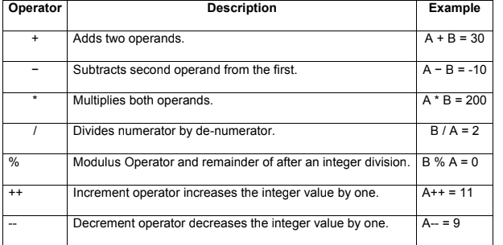
C Arithmetic Operators

Slide 45
Example
Int a = 9, b= 4, c=
c = a+b;
printf("a+b = %d \n",c);
c = a-b;
printf("a-b = %d \n",c);
c = a*b;
printf("a*b = %d \n",c);
c = a/b;
printf("a/b = %d \n",c);
c = a%b;
printf("Remainder when a divided by b = %d \n",c);

Slide 46
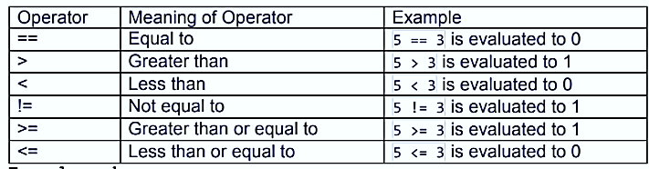
C Relational Operators
A relational operator checks the relationship between two operands. If the relation is true, it returns
1; if the relation is false, it returns value 0.

Slide 47
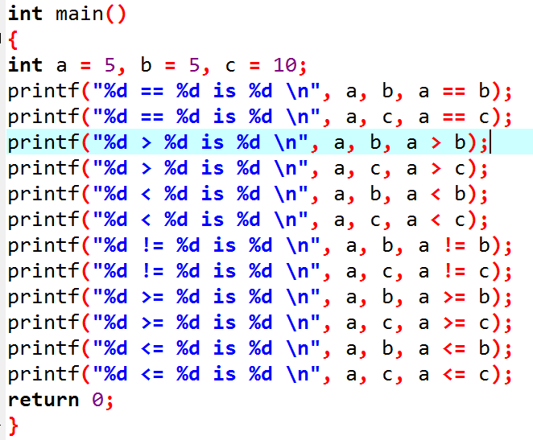
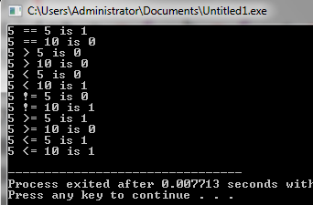
Example

Slide 48
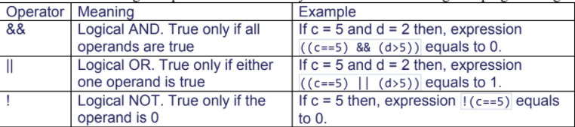
Logical Operators
An expression containing logical operator returns either 0 or 1 depending upon whether expression
results true or false. Logical operators are commonly used in decision making in C programming.

Slide 49
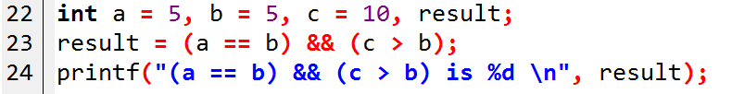
Example

Slide 50
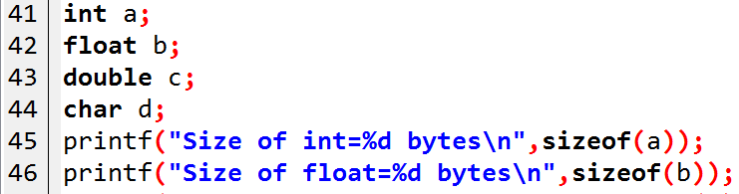
Size of() operator

Slide 51
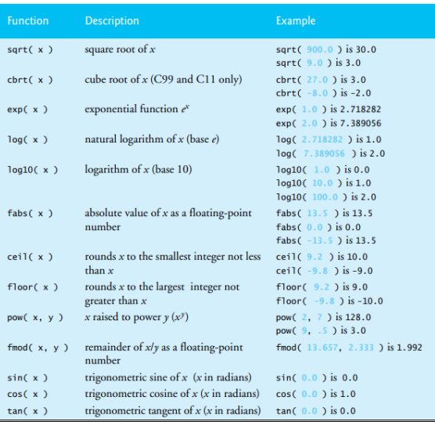
Math Library
printf( "%.2f", sqrt( 900.0 ) );

Slide 52
Thankyou

